Slide 1

Making the case for RDM – from pilots to sustainable services
This work is licensed under the Creative Commons Attribution 2.5 UK: Scotland License.
Notes:
Now that we’ve set the scene for today. We’ll get started on thinking about scoping and refining user requirements.
Without a solid understanding of what users want, it is impossible to develop services that will be used and valued. For the next 20 minutes, we’ll share some tips on how to start assessing user requirements at your institution. We’ve distilled key points from our How to Develop RDM
Services and How to Discover Requirements for Research Data Management Services guides – both are included in your packs so that you can delve into these in more detail once you return home.

Slide 2
What is the national picture in the UK
Policy and strategy – 87%
Business planning – 13%
Data Management Planning – 50%
Data cataloguing – 38%
Managing active data – 40 %
Data preservation – 18%
Governing access & reuse – 22%
Skills training & consultancy – 63%
% indicating ‘rolling out’ or ‘embedding’
Notes:
To give you an idea of RDM service provision in the UK, here is mapping of the 2015 DCC annual survey. Reflects responses from 60 institutions and is mapped to the DCC RDM services model.
Majority of UK HEIs making good progress in developing training and guidance. Longer term preservation and business case development are proving more difficult across UK HEIs. These will have an impact on training provision as well.

Slide 3
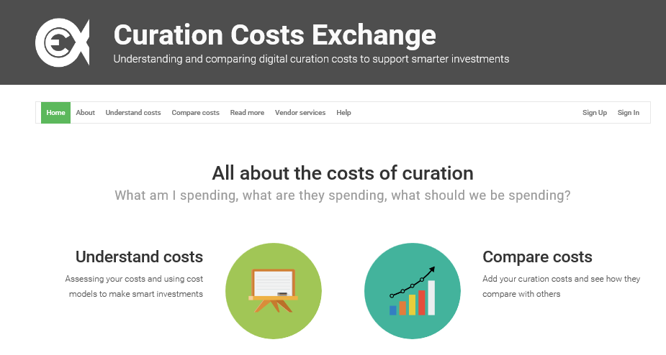
Tools for assessing costs
http://www.curationexchange.org/

Slide 4
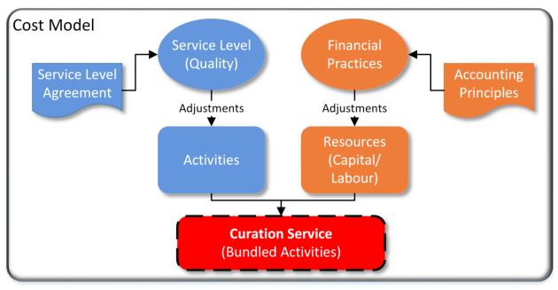
4C cost model
D3.2- Cost Concept Model and Gateway Specification http://www.4cproject.eu/d3-2-ccm-grs
Notes:
Cost models apply and extend the resource and activity concepts (see section 3) to meet a given set of use
cases. Direct and indirect costs are defined in terms of a specific approach to capturing capital and labour
costs for a set of activities.
Past costs may be counted or future costs estimated with a view to:
• Comparing actual costs over time in a standardised way
• Comparing past costs to estimated future costs
• Comparing the projected cost of two or more curation options
• Comparing one organisations costs to another’s
Local Financial Practices are used (in line with prevalent Accounting Principles) to apply appropriate
adjustments (inflation, deflation, depreciation, interest etc.) which support the calculations relating to the
expenditure of resources in terms of capital and labour.
Curation activities are clearly defined down to an agreed level of granularity. For ‘Activities’ adjustments
may be made to ensure an agreed level of quality. A Service Level Agreement (SLA) may be developed to
formally manage quality levels between the provider and consumer (see A Business Model for Curation).
Together these interactions between the core cost concepts form a cost concept model for curation. A
given set of activities undertaken with a given quantity of resources provide us with a Raw Curation
Service with an associated cost.

Slide 5
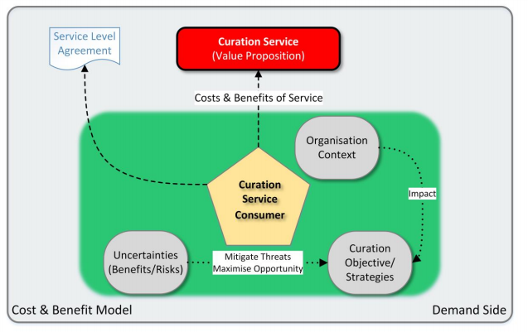
4C cost and benefit model
Not just about costs – think about risks and value
D3.2- Cost Concept Model and Gateway Specification http://www.4cproject.eu/d3-2-ccm-grs

Slide 6
Cost drivers
Efficiency
Reputation
Trust
Confidentiality
Transparency
Interoperability
Notes:
Remember to consider drivers for your organisation in determining your value proposition. For instance, many funder sponsored and/or national data centres are keen to establish themselves as trusted digital repositories. In the case of institutional data repositories, the drivers may be more aligned with transparency and compliance with external mandates such as EPSRC.

Slide 7
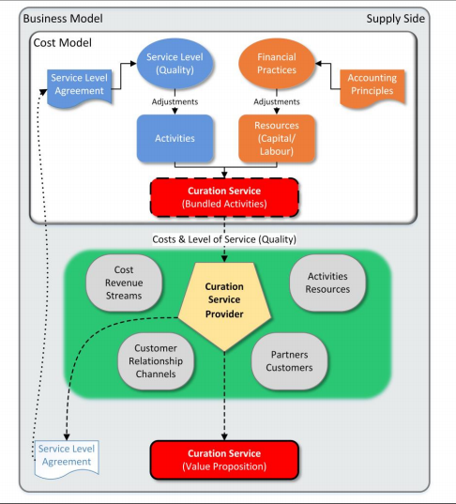
4C business model
D3.2- Cost Concept Model and Gateway Specification http://www.4cproject.eu/d3-2-ccm-grs

Slide 8

Defining metrics
What should we measure?
How do we measure it?
http://blog.kksmarts.com/wp-content/uploads/2013/05/tape_measuring_success_6539.jpg

Slide 9
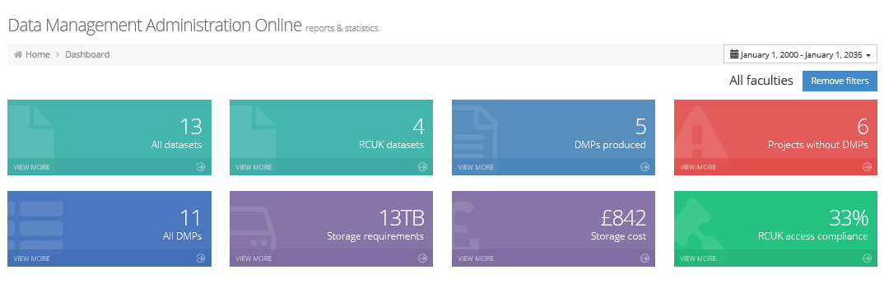
Gaining business intelligence
http://lib-ldiv.lancs.ac.uk:8080/dmaonline/dashboard/index.html#/

Slide 10
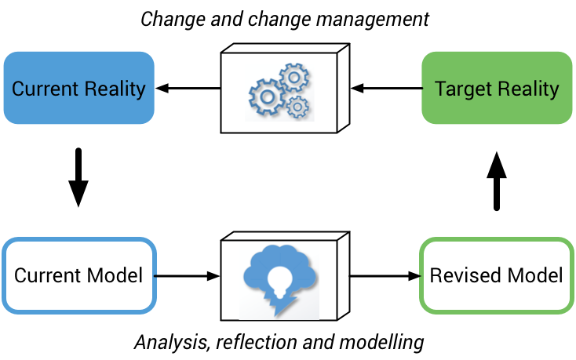
Sustainability of your business model
http://www.curationexchange.org/
Notes:
Keep in mind that the business model you use now is unlikely to remain a perfect fit for your organisation over the longer term. Changes in legislation, evolving stakeholder needs, and potential new revenue streams necessitate the ongoing evaluation and refinement of your business model to ensure that your operations remain viable over time.
It is important to set aside time and effort to actively monitor your business model. By doing so you put yourself in a better position both to respond in a more agile manner to evolving organisational context and stakeholder needs, and to reassess how you deliver services and activities in the face of evolving resources and cost drivers.

Slide 11

Thanks for listening!
DCC guidance, tools and case studies:
www.dcc.ac.uk/resources
Follow us on twitter:
@digitalcuration and #ukdcc

